Slide 1
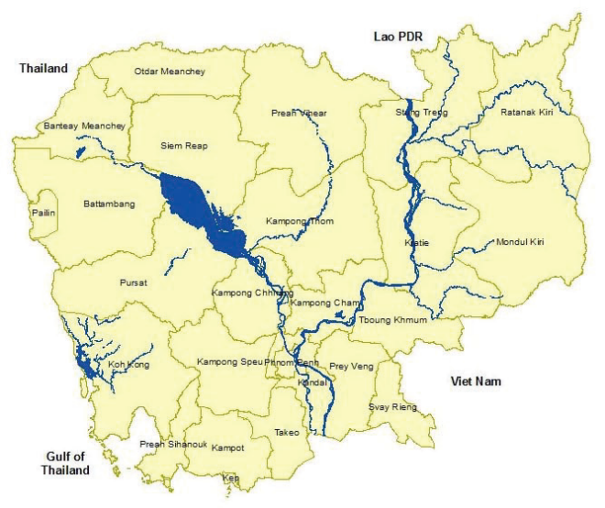
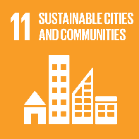
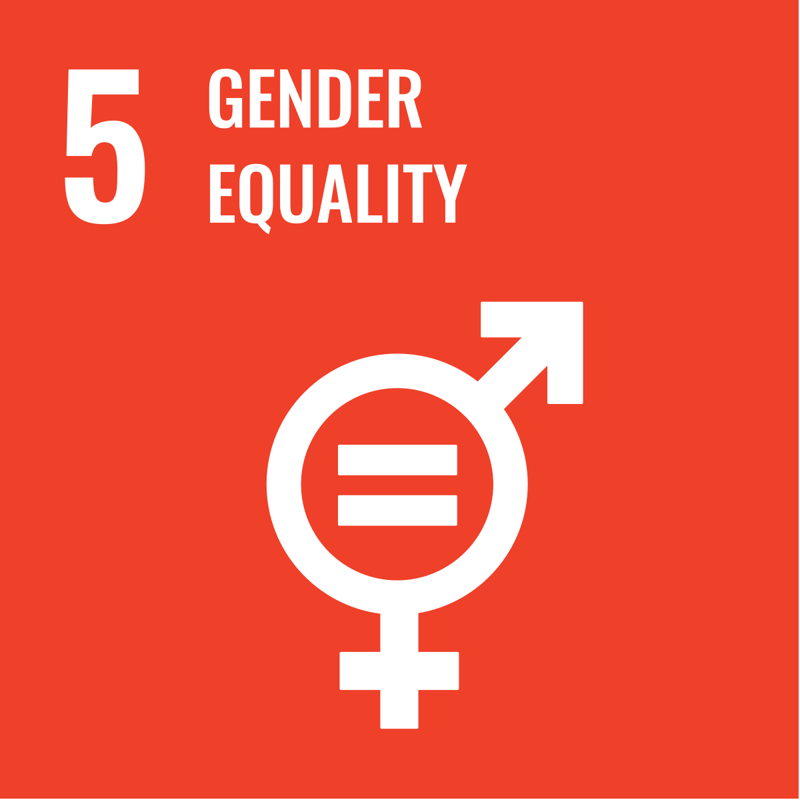
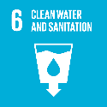
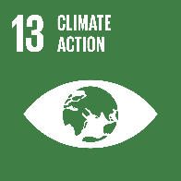
Strategic Plan
2026-2028
Vision
A world where everyone has a decent place to live
Habitat Cambodia seeks to impact the lives of 1,849,236 people in Cambodia by 2028
Building More & Better Homes Improve housing conditions for more than 39,200 people (19,600 women) through new, repaired, improved, rehabilitated, and incremental house construction. | Transforming Housing Systems 159,310 people (79,600 women) have access to affordable housing through market development. Strengthen Habitat’s position to contribute to policy changes that advance access to quality, affordable housing that benefits 1,647,606 people (823,800 women). | Inspire Action for Housing Mobilize at least 3,120 people (1,500 women) and activate deeper engagement around housing
Cambodia
Targets
The National Housing Policy 2014 indicated a need for 1.1 million additional houses by 2030⁽¹⁾.
In 2025, 42.3% of the urban population (1,788,028 people) live in slums or inadequate housing conditions, vulnerable to climate hazards⁽²⁾⁽³⁾. Urban population is 4,230,035 (25% of the total 16,843,333), expected to grow to 30.6% by 2030 and 41.1% by 2050⁽⁴⁾.
As of 2025, approximately 31% of Cambodian households (1,216,909 out of a total of 3,906,665 households) are poor (in the poverty line) or at-risk households (above the poverty line), including 715,244 poor and 501,665 at-risk households⁽⁵⁾. Nearly 47% of Cambodia’s poor or at-risk households are female-headed, reflecting the gendered nature of poverty driven by limited resources, weak social protection, and unpaid care burdens.
87% of Cambodia's population has access to basic drinking water, while only 21% have access to safely managed drinking water. Approximately 92% of the population has access to basic sanitation, but only 51% have access to safely managed sanitation⁽⁶⁾ ⁽⁷⁾.
Cambodia is highly vulnerable to climate change and natural disasters, which impact socioeconomic stability and food security. Without adaptation measures, climate change could cost up to 9% of GDP by 2050 and increase poverty rates by 6% by 2040⁽⁸⁾. Women in Cambodia have a lower resilience index of 0.56 compared with 0.59 for men⁽⁹⁾.
Build Resilient Housing: Build resilient and inclusive rural and urban communities through safe and adequate housing, integrated climate action, HDRR, and equitable access to basic services.
Strengthen the housing governance and systems: To contribute to the development, improvement, and effective implementation of housing policies, systems, and service delivery towards safe, adequate, and affordable housing
Influence housing market development: To enhance access to the affordable housing market through capacity development and partnership on affordable housing finance for low-income households in Cambodia.
Cross-cutting priority program: **Inspire Action for Housing: Volunteer for/ in Development, which mobilizes volunteers and institutional engagement for building and influencing the cause of housing issues. ** Gender Equality, Disability and Social Inclusion (GEDSI), ** Sustainable Development Goals (SDGs), ** Partnerships and Constructive Dialogues, ** Organizational Capacity and Sustainable Development, ** Operational model, systems, and process strengthening ** Program Quality, Innovation, MEAL, ** Communication and Brand Visibility, ** Governance, Compliance, Safety and Security, Risk Management, ** Resources Mobilization.
Program Priorities
Target
Populations
Habitat works with people whose housing conditions are inadequate due to systemic exclusion and vulnerability
Informal Settlers in slum and squatter area | Women and Vulnerable* | Women and Vulnerable* |  | Low Income** | Low Income**
 | A | A
Habitat responds to the stressors and shocks that allow the housing deficit to persist and grow
Urbanization | Policy and Governance |  | Climate change and Natural Disasters |  | Multi-Dimensional Poverty
Sources: (1) Cambodia’s Policy Ask, (2) UN-Habitat: Cambodia Country Report 2024, (3)The Asian Development Bank's (ADB): Key Indicators Database, (4) Ministry of Planning: IDPoor database (5) Knight Frank Report: Growing Demand for Affordable Housing and Branded Residences in Cambodia and the Asia-Pacific Region for 2025 - Cambodia Investment Review, (6) Ministry of Rural Development (MRD) (2023): Annual Report on Post-ODF Strategy Implementation, (7) Khmer Time, (8) World Bank (2023): Acting on Climate Change is Key for Cambodia to Achieve its Development Goals, (9) ActionAid Cambodia 2021 – Woman Champion in Disaster Risk Reduction and Climate Change;
Major Trends

